Slide 1
Global EQ PCF (GEP)
Q3 2018

Slide 2
GEP Objective
Implement a common methodology for publishing Cr/Rd PCFs and any supplemental information to the market. This breaks down into two streams:
Move to globally consistent PCF methodology and process using
Unitized cut basket methodology
Global Inferred Cash (GIC)
Standard way of projecting orders
Enable Badger (or Iterative/Enhanced/Optimized Rounding) to minimize cash where appropriate and allowable
Move to globally consistent and industry leading fund data through the Fund Data File (FDF)
Publish one FDF per fund that provides all PCF-related information to APs/MMs
FDF is product agnostic
Retire old PCFs and supplemental files that become redundant due to the FDF
Through the FDF provide accurate risk pricing from market open to close with a deliverable basket that matches the fund exposure at NAV date

Slide 3
GEP Target Feature Set and Where We’re At Implementation
GEP Feature Set
Implementation Status
 | EMEA | APAC | AMRS
Unitized | Mkt Value Wgtd → Unitized | Mkt Value Wgtd → Unitized | Already on Unitized
Global Inferred Cash (GIC) | Simple Inferred → GIC | Simple Inferred → GIC | Bottom Up → GIC
Standard Order Projections | Yes | Yes | Yes
Badger/Enhanced Rounding | Yes | Yes | For select funds authorized by US Legal
Fund Data File (FDF) | Yes | Yes | Yes
(As of October 24, 2018) | EMEA⁽¹⁾ | APAC | AMRS
Unitized | Completed Apr 24 | Completed Jun 28 | Already on Unitized
Global Inferred Cash (GIC) |  |  | Completed Oct 16
Standard Order Projections |  |  | Target Jan 2019⁽²⁾
Badger/Enhanced Rounding |  |  | Target Jan 2019
Fund Data File (FDF) | Completed Apr 25 | HK – Completed Sep 4 AU – Target Nov 12 JP – Target Dec | Target Jan 2019
(1) Excluding physical commodities and swaps funds (Dixie modules UKPC, UKSW, DEPC, DESW)
(2) Order Projections on PRICING basket complete except FDEQ, SAEQ. Order Projections on DELIVERABLE basket is targeted for Jan 2019

Slide 4
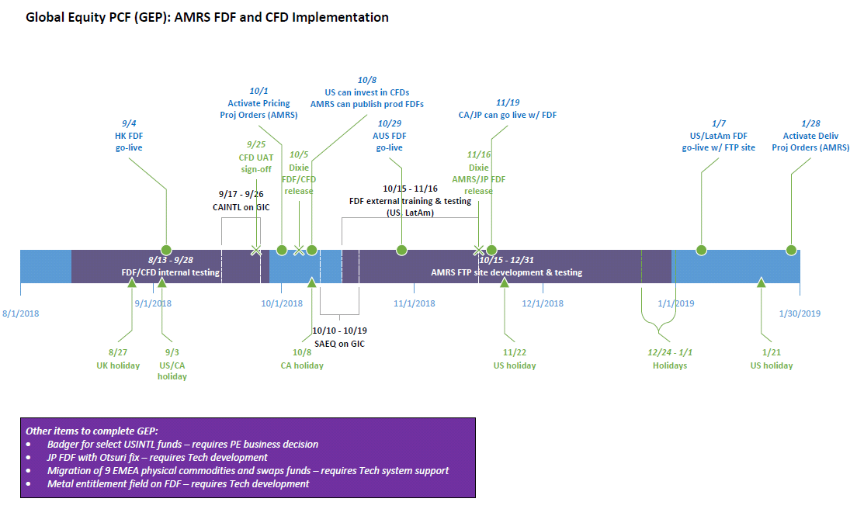
Timeline

Slide 5
GIC: Overview
Seamless change for EMEA and APAC as they are already on a version of inferred cash (called Simple Inferred Cash)
Significant change for AMRS from Bottom Up cash calculation
Formula change
Projected Cash = Fund NAV – Market Value of Basket + Adjustments
where:
Adjustments = Projected Income + Delta Dividends + Trade Variance + Manual cash adjustments
Projected Income = Dividends per unit - Expenses per unit - Distributions per unit + Projected Complex Corporate Actions per unit + Other CCF components
New Cash Research screen replaces current “valuator” screen
New validation rules (next slide)
Vishal’s detailed PPT deck on GIC (also in Appendix)

Slide 6
GIC: New validation rules
Validation rules are fund configurable, e.g. negative cash validation (#6) is not turned on for AMRS currency hedged funds
Parameter values can be defined on a fund-by-fund basis
If triggered, results in a soft stop in Dixie

Slide 7
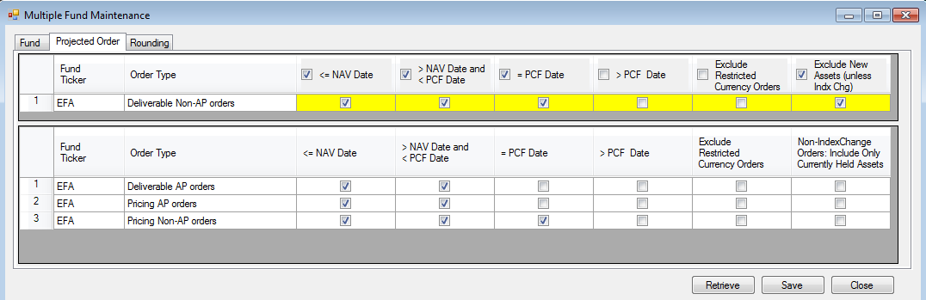
Order Projections: Overview
Logic for projecting open orders has been enhanced and standardized to account for motivation (AP or non-AP) and basket (pricing or deliverable) across different time periods
New Dixie screen, with default settings standardized across fund domiciles
3 date checkboxes → 4 date checkboxes
Additional checkboxes specific to US:
Exclude restricted currency orders
Exclude new assets unless part of index change
< PCF Date
= PCF Date
> PCF Date
<= NAV Date
> NAV Date and < PCF Date
= PCF Date
> PCF Date
This flag will be removed
New flag specific to US funds
Top yellow rows editable by PE in the GUI
4 date checkboxes
Bottom rows editable by Tech in the back-end

Slide 8
Order Projections: 5 Standard Settings, based on fund domicile (1 of 2)
Red denotes differences from the “Global” Standard. The “Global” Standard applies to all funds unless noted as one of the variants above.
White rows denote editable by PE on the Dixie GUI vs. gray rows denote editable by Tech on the back-end.

Slide 9
Order Projections: 5 Standard Settings, based on fund domicile (2 of 2)
Red denotes differences from the “Global” Standard. The “Global” Standard applies to all funds unless noted as one of the variants above.
White rows denote editable by PE on the Dixie GUI vs. gray rows denote editable by Tech on the back-end.

Slide 10
Badger: Overview
New functionality that allows PEs to target (hence minimize) deliverable cash
Attempts to reinvest/reallocate excess cash among securities in the basket, while deviating from the current fund weights as minimally as possible
For EMEA and APAC: Unitized + Badger similar to MVW cutting
For US: constrained by ‘40 Act exemptive relief; Legal has limited its usage to “eliminate the cash effects of rounding with weight of cash in basket not to exceed weight of cash and accruals in the fund”
Logistics of running Badger
If a fund is authorized and enabled to run Badger, it is run during the Cut PCF process after the basket has been cut using the fund’s default rounding methodology (e.g. round up, round down, or conventional rounding)
PEs define their target cash levels and the allocation constraints Badger should adhere to when attempting to reallocate cash to basket securities
Badger is run on the deliverable basket (not pricing basket)

Slide 11
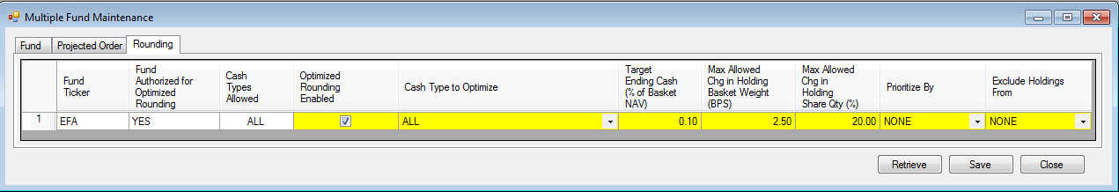
Badger: Input Screen
Located in Multiple Fund Maintenance screen, new “Rounding” tab
Yellow cells are editable by PE on the screen
Input parameters to the Badger algorithm:
Your desired deliverable cash as a % of basket NAV
Max amount of weight Badger can add to a holding beyond its current ‘perfect’ fund weight (e.g. if constraint is 2.5 bps, Badger will not add more shares to a name if it would take the weight higher than 2.5 bps than current fund weight)
Max % change in # shares Badger can add to a holding (e.g. if current # shares of a security is 100, Badger can add up to 20 additional shares)
Checkbox to run/not run Badger
Fund needs to be authorized for Badger by Legal/Mgmt. Once authorized, Tech will activate it on the back-end.
You can have Badger reallocate different types of cash:
All cash
Cash from odd lots only
Cash from odd lots and all excluded securities
Cash from odd lots and excluded equity securities
Cash from odd lots and excluded futures
You can have Badger reallocate cash by:
None = No priority
Country = Allocate cash to most underweighted countries first
You can have Badger reallocate cash by:
None = No exclusions, i.e. all assets are eligible to receive additional shares/weights
UK = Exclude UK securities, i.e. do not add additional shares/weights to UK securities (to maintain exemptive relief on UK stamp tax)

Slide 12
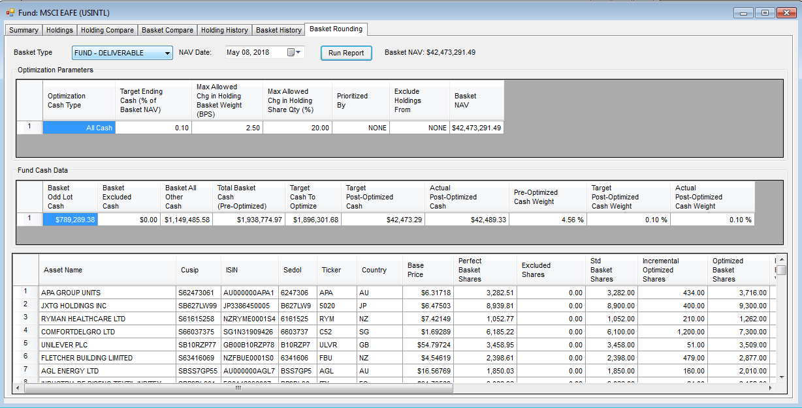
Badger: Output Screen (1 of 2)
Located in Fund–>View Holdings/Basket screen, new “Basket Rounding” tab
Output screen divided into 3 panels: top, middle, bottom
Top panel shows what your cash optimization targets/tolerances are (same as input screen).
Last column shows Basket NAV. In this case, you want an ending cash of 0.1% of Basket NAV or $42,473.29.
Middle panel shows cash details on the fund level, e.g.
$1,938,774.97 = cash component of basket before Badger
$1,896,301.68 = cash you want Badger to reallocate
$42,473.29 = desired cash after running Badger
$42,489.33 = actual cash after running Badger
and what %s of Basket NAV these cash amounts represent
Basket Cash from odd lots
Basket Cash from excluded securities
Starting Total Basket Cash = sum of columns A to C
Cash you want Badger to reallocate = D – F
Desired ending cash (here, 0.1% of Basket NAV)
Actual ending cash (i.e. after Badger)
Starting Total Basket Cash (D) as % of Basket NAV
Desired ending cash (F) as % of Basket NAV
Actual ending cash (G) as % of Basket NAV
A
B
C
D
E
F
G
H
I
J
Basket Cash from “other”, mostly accruals & spendable cash
Bottom panel shows details on the individual holdings level, how Badger’s reallocation of cash translates to qty changes at the holdings level, e.g.:
Perfect Basket Shares = # shares given perfect slice of the basket (= fund holdings / fund units; displays fractional positions with no round lots applied)
Excluded Shares = # shares excluded
Standard Basket Shares = # shares respecting local market round lots and given the fund’s default rounding methodology
Incremental Optimized Shares = additional # shares added to the deliverable basket due to Badger’s reallocation of cash
Optimized Basket Shares = Standard Basket Shares + Incremental Optimized Shares

Slide 13
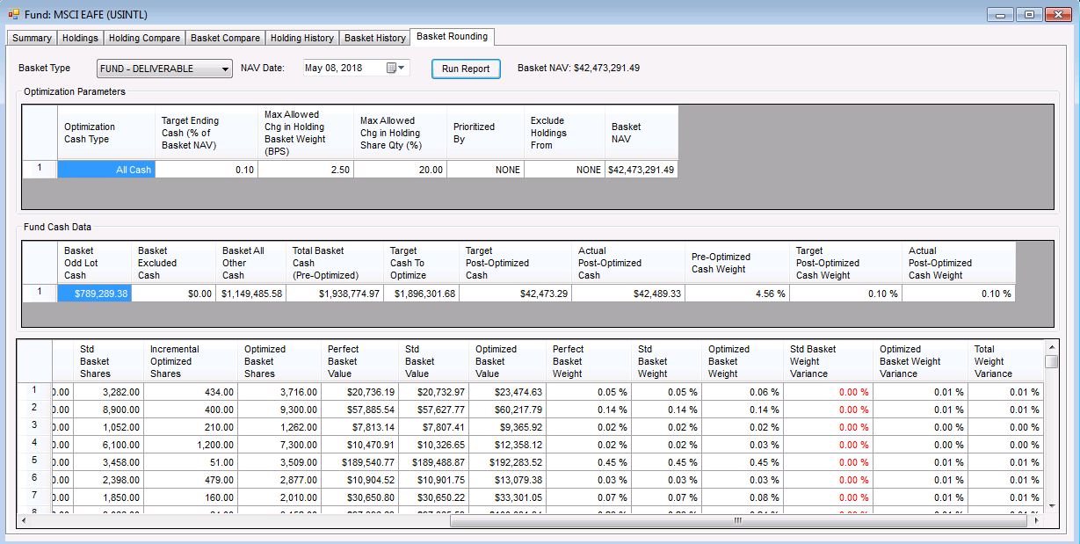
Badger: Output Screen (2 of 2)
Expanded bottom panel
Top panel shows what your cash optimization targets/tolerances are (same as input screen).
Last column shows Basket NAV. In this case, you want an ending cash of 0.1% of Basket NAV or $42,473.29.
Middle panel shows cash details on the fund level, e.g.
$1,938,774.97 = cash component of basket before Badger
$1,896,301.68 = cash you want Badger to reallocate
$42,473.29 = desired cash after running Badger
$42,489.33 = actual cash after running Badger
and what %s of Basket NAV these cash amounts represent
Basket Cash from odd lots
Basket Cash from excluded securities
Starting Total Basket Cash = sum of columns A to C
Cash you want Badger to reallocate = D – F
Desired ending cash (here, 0.1% of Basket NAV)
Actual ending cash (i.e. after Badger)
Starting Total Basket Cash (D) as % of Basket NAV
Desired ending cash (F) as % of Basket NAV
Actual ending cash (G) as % of Basket NAV
A
B
C
D
E
F
G
H
I
J
Basket Cash from “other”, mostly accruals & spendable cash
Bottom panel (continued) shows details on the individual holdings level, how Badger’s reallocation of cash translates to qty changes at the holdings level, e.g.:
Perfect / Standard / Optimized Basket Value = market value of security given perfect slice of the basket / basket based on fund’s rounding methodology / Badger basket
Perfect / Standard / Optimized Basket Weight = security weight given perfect slice of the basket / basket based on fund’s rounding methodology / Badger basket
Standard Basket Weight Variance = how much the security weight deviates from that of the perfect basket
Optimized Basket Weight Variance = how much the security weight deviates from that of the standard basket
Total Weight Variance = Standard Basket Weight Variance + Optimized Basket Weight Variance

Slide 14
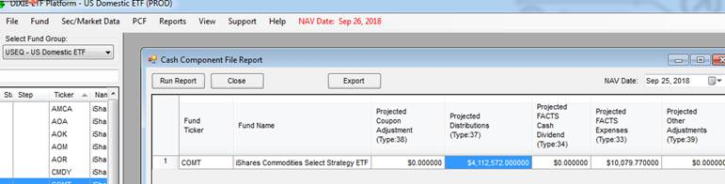
FDF: Overview
Produce and publish a daily FDF per fund that will provide all PCF and supplemental PCF related information to APs/MMs in order for them to accurately price and transact in the fund
Pricing Basket: APs will price off of this basket; will display a perfect slice of the fund, giving total transparency over holdings. It will only include projections valid for the day of issue, including T+1 funds.
Deliverable Basket: List of securities that APs deliver in/out as part of primary market activity; in effect the ‘old’ PCF
Excluded Basket: Will display any assets we had to exclude from both the pricing and deliverable baskets (names that are difficult to price, e.g. complex CoAcs, suspended names). This removes the need to publish an excluded assets file and makes the FDF a single source of information.
Superset of all the data points across the regions – if a data point is not relevant to the region, we show the data header/label but leave the value empty/blank
Global FDF template and FDF Data Dictionary
Need discussion on: Distribution per Share, currently sourced from CNAV/CCF

Slide 15
Portfolio Composition File (PCF) vs Fund Data File (FDF)
 | PCF | FDF
What does it contain? | Deliverable Basket | Deliverable Basket List of securities to be delivered in/out, or traded, as part of primary market activity Inclusive of projected fund trades effective on NAV date Round Lot Positions Pricing Basket Inclusive of ALL readily priced securities held in the fund Effectively a slice of the fund unrounded Excluded from Pricing assets
How is it used? | Previous day’s file for risk pricing Today’s file for deliverable security list | Today’s Pricing Basket for intraday risk pricing Today’s Deliverable Basket for security list for primary market orders
Benefits
Reduced spreads in EMEA
Scale
Having the same PCF process in all regions will help get us closer to 24/5 order taking & simplify business continuity practices.
Better portability of ETF features across asset classes and regions: e.g. currency hedging, multiple share classes
Reduces the support burden on the iShares technology team
More consistent AP experience
Align Portfolio Engineer process globally and enhance Tracking Error in funds

Slide 16
FDF: Global Rules on Inclusion/Exclusion from Pricing Basket
PE Business Rules when to include/exclude securities from the pricing basket
Red = exclude from pricing basket
Yellow = PE discretion whether to exclude from or include in pricing basket
Green = include in pricing basket

Slide 17
FDF: Required Market Identifiers (by region)
Required Valid Market Identifiers
Enhancement: Need to have at least 1 valid identifier for the pricing basket – this has been enhanced so that if the only valid identifier you have is a SEDOL, then make sure it’s not a dummy SEDOL

Slide 18
Appendix
Global Inferred Cash (GIC)

Slide 19
Global Inferred Cash
Q1 2018

Slide 20
Contents
Current model - Bottom Up Projected Cash
Inferred cash - What and Why
Inferred cash - Progress & Rollout Plan
Inferred cash - Validations & Error Handling
Inferred cash - Things to Note

Slide 21
Current model - Bottom Up Projected Cash
For US & CA funds DIXIE builds up projected cash using the below formula:
Using fund accounting cash as the starting point presents challenges:
Differences in CoAc processing dates between Aladdin and SSB lead to cash variances
T+1 accounting means that all trades and C/R activity on T has to be adjusted for by DIXIE
The benefit of this approach is that we can validate that:
Mkt Value of Basket + Projected cash – Adjustments = Fund Accounting NAV
Fund Acctg Cash Component/Fund
+
Trade List Cash Adjustment/Fund
+
Excluded Asset Cash /Fund
+
Projected Rounding/ Odd Lot Position
+
Manual Cash Adjustment/Fund
+
Cash from Contribution/Redemption
+
Projected Coupons
+
Delta Dividends H
=
Projected Cash Component

Slide 22
Inferred cash – What and Why
The basic inferred cash formula is:
Projected Cash = Fund NAV – Mkt Value of Basket + Adjustments
Adjustments are cash items that are used to enhance cash so that it provides similar information as today’s bottom up cash
Adjustments = Projected Income + Delta Dividends + Trade Variance + Manual cash adjustments
Projected Income = Dividends per unit - Expenses per unit - Distributions per unit + Projected Complex Corporate Actions per unit + Other CCF components
The benefits of this approach are:
CoAc differences between BLK & SSB are automatically plugged
Cash from C/R activity is plugged (including CIB or SAC cash)
Globally consistent (EMEA & APAC effectively use this approach today)
Challenges with inferred cash
Reliant on basket pricing being accurate
Need accurate CoAc and trade data to ensure baskets are accurate
Lose the ability to validate FA NAVs
We have observed fewer NAV errors in the recent past

Slide 23
Inferred cash - Progress & Rollout Plan
Current Status
We have been validating the inferred cash formula and comparing results to production cash values
As a result of this we’ve identified several validation enhancements:
Negative cash check
Trade variance and trade price check
Day over day (DoD) cash check
Non-CCF priced asset counts
New GUI screen to help with research & validation of DoD changes
Next Steps
Identify funds to use for parallel testing in DIXIE Beta
Similar to Proj. Vision compare production projected cash to inferred cash in Beta over some time period
Convert all US & Canada funds to use inferred cash
We can also potentially turn on “Auto-submit” at Go-Live

Slide 24
Inferred cash - Validations & Error Handling
With the roll out of GIC, the existing PCF Valuation compare report will be replaced with a new “Cash research” screen which will:
Show the components of the GIC calculations
Identify & validate day over day (DoD) changes in cash and attribute the change to known activity
Report mockup
Exceptions/Validations that will result in hard stops:
Missing prices
Missing Identifiers
Negative cash (unless the fund is hedged/levered)
Exceptions/Validations that will result in soft stops:
Corporate actions with invalid payout statuses
Unexplained DoD change over certain threshold
Trade price/Trade Variance over certain threshold

Slide 25
Inferred cash – Things to note
Trade Cash Variance: Including this in the GIC formula is configurable in MFM
Delta Dividends: This is a background configuration that is done by the support team
Projected Income: This is a value that is provided in EMEA/APAC CNAV files but for US/CA funds will be built up

Slide 26
Appendix

Slide 27
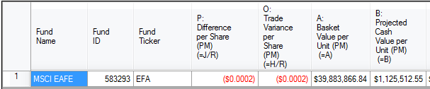
Bottom up cash in detail
Data | Value | Source | Why/What?
Fund Acctg Cash Component/Fund | $ 620,099,816.17 | FA | Starting point, represents all FA cash (Spendable + Accruals) based on T+1 accounting and a projection of next day expenses and divs
+ | +
Trade List Cash Adjustment/Fund | $ (58,835,129.52) | Aladdin | Adjusts FA cash for IBOR trading activity
+ | +
Excluded Asset Cash /Fund | $ 273,421,716.21 | DIXIE | Value of excluded assets
+ | +
Projected Rounding/ Odd Lot Position | $ 1,375,820,242.69 | DIXIE | Value of odd lots
+ | +
Manual Cash Adjustment/Fund | $ - | PM | Usually represents CoAcs differences between SSB & BLK
+ | +
Cash from Contribution/Redemption | $ - | DIXIE | Adjusts FA Cash for T activity
+ | +
Projected Coupons | $ - | Aladdin | FI Coupons
+ | +
Delta Dividends H | $ - | DIXIE | Scales projected dividends from FA for
= | =
Projected Cash Component | $ 2,210,506,645.55 | DIXIE | Estimated projected cash at the fund level
EFA as of NAV Date 10/06/17
Units out = 1,964
Projected cash/unit = $2,210,506,645.55/ 1,964 = $1,125,512.55 (Amount published in the PCF)

Slide 28
Validations
Category | Exception | New / Old | Logic/Notes
Missing Data | Missing prices | Old
Missing Data | Missing Identifiers | Old
Missing Data | Missing FX Rate | Old
Missing Data | Missing AI | Old
Missing Data | Missing NAV/AR ratio | New | Do we need this check or is there CCF/CNAV validation in place?
Trade Variance | %Trade Variance | New | Flag if Trade Variance/NAV is greater than X%.
Trade Variance | Trade price check | New | Flag if abs(tradeprice/closeprice -1) on an individual trade is greater than X%. Will help ensure that fills are in reason
Cash Check | Unexplained DoD Cash/Unit level changes | New | Flag if DoD cash change cannot be fully explained
Cash Check | Negative cash validation -- Deliverable Basket Cash | New | Check if PCF is levered. Would need to be fund configurable so that hedged or levered funds can be excluded from this check
Cash Check | Target cash levels (Needed for Badger) | Old | Used today for MVW funds; not currently being run in PROD per Amita
Basket check | Min/Max basket asset count (A50 or Nasdaq 100) | New

